Slide 1


Slide 2
Exploring the Bacterial Genome using Data Science

Slide 3

Introductions

Slide 4

Who am I?
Hayden Sansum
Lead Data Scientist at Day Zero Diagnostics
Data Science professional for 9+ years
Interests
Coffee (drinking and making)
Hiking & Skiing
Miniature painting
Baldur’s Gate 3
Sewing

Slide 5

Who are you?
Want to encourage open discussion during these workshops
We will start every session with everyone giving an update on their week!
For each session come prepared with anything you did/saw that you thought was interesting or what you’re looking to learn from the upcoming session
For today, please tell us a little about yourself!:
Name + School & Course of Study
What do you want to learn from this workshop?
One hobby or an event you enjoyed recently?

Slide 6
Why are we here?

Slide 7
QUIZ TIME !?
What is “Antibiotic Resistance”?
When the human body becomes immune to antibiotics
When antibiotics become more effective over time
When bacteria evolve to survive exposure to antibiotics
When antibiotics start a protest

Slide 8
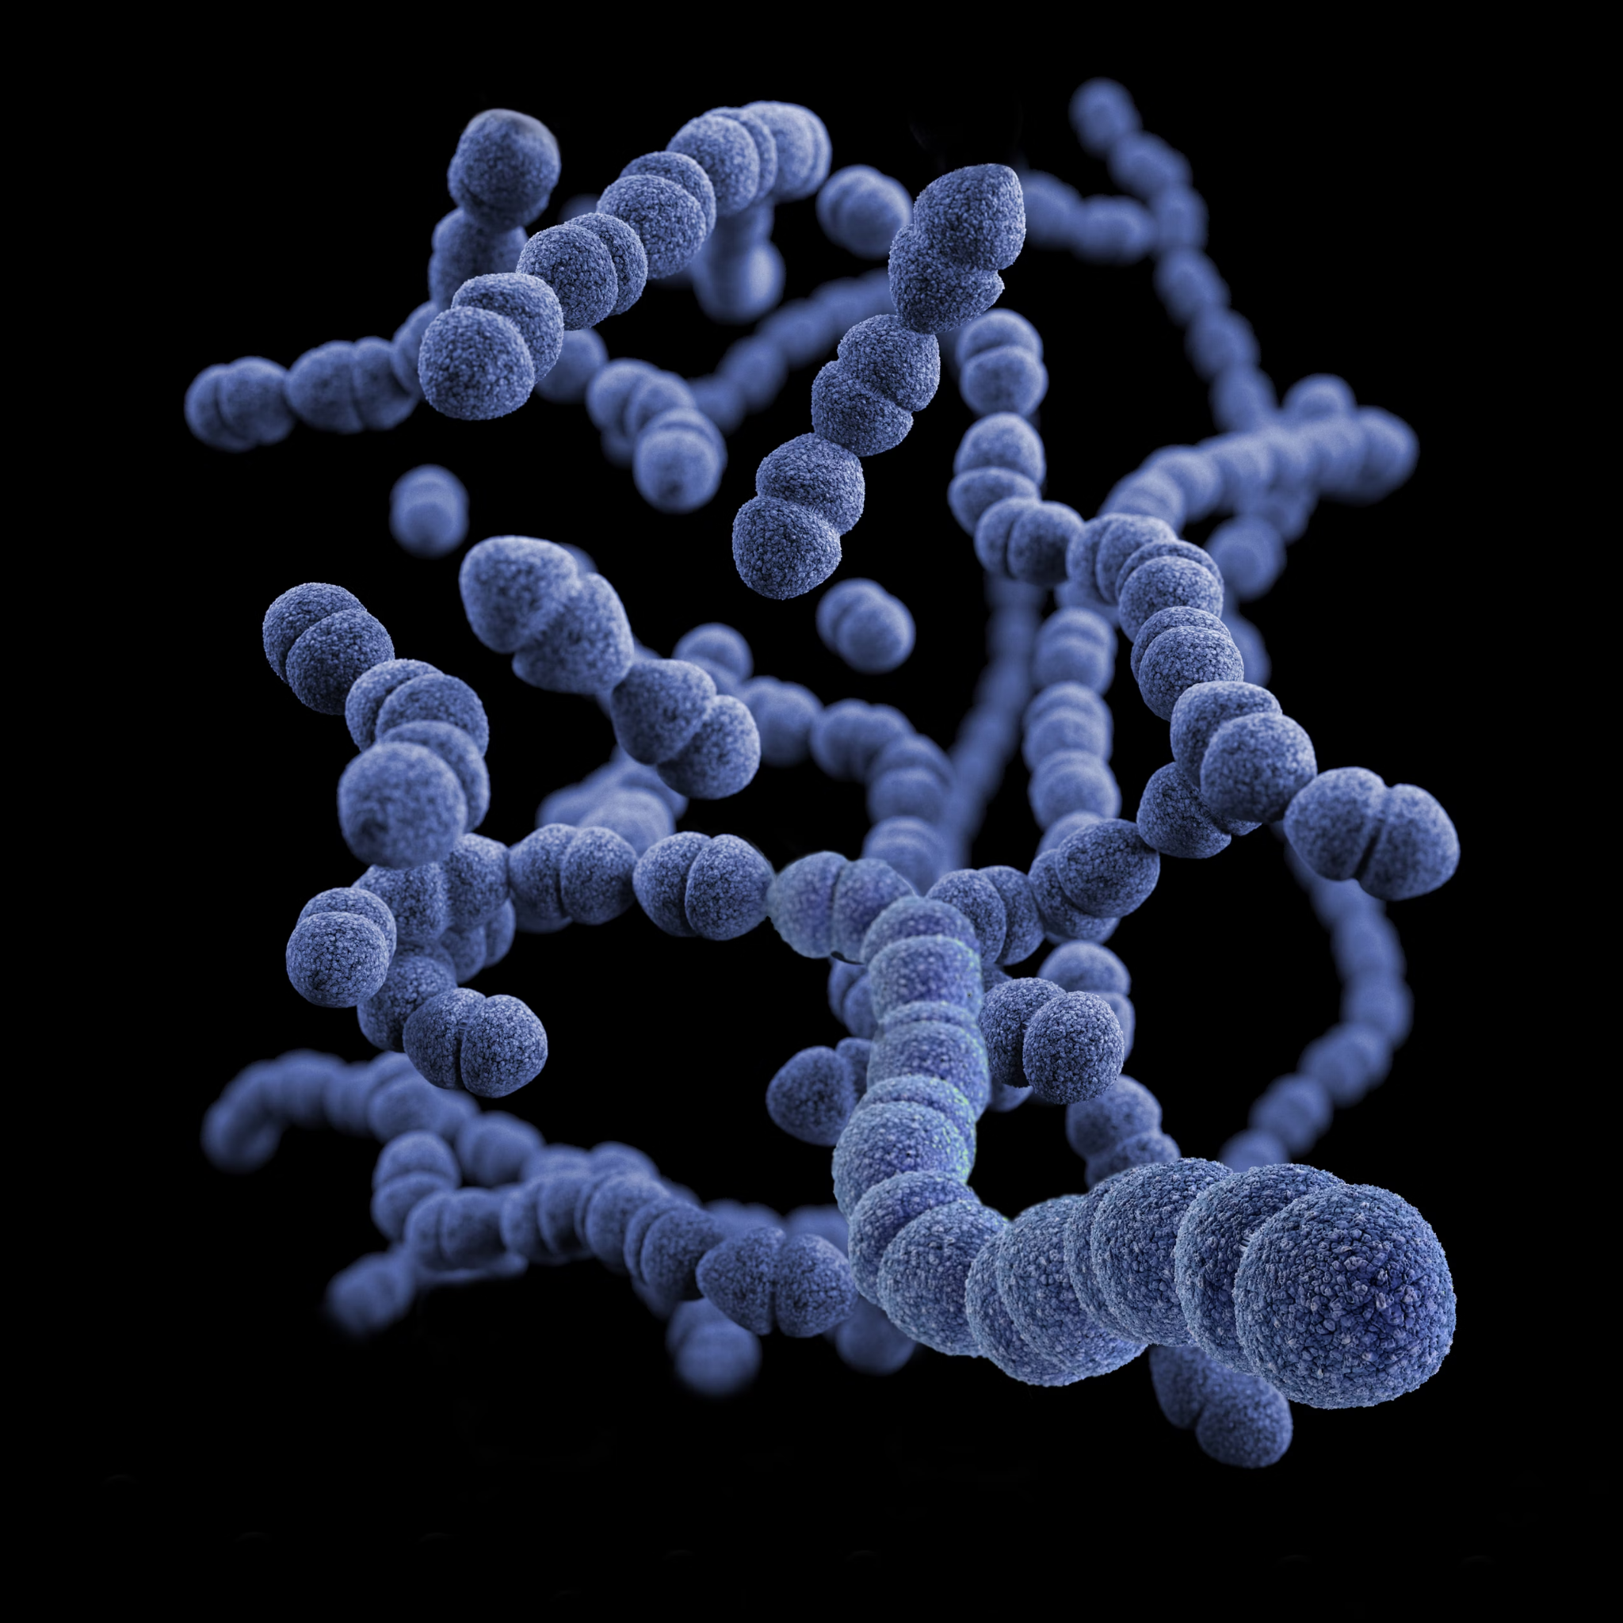
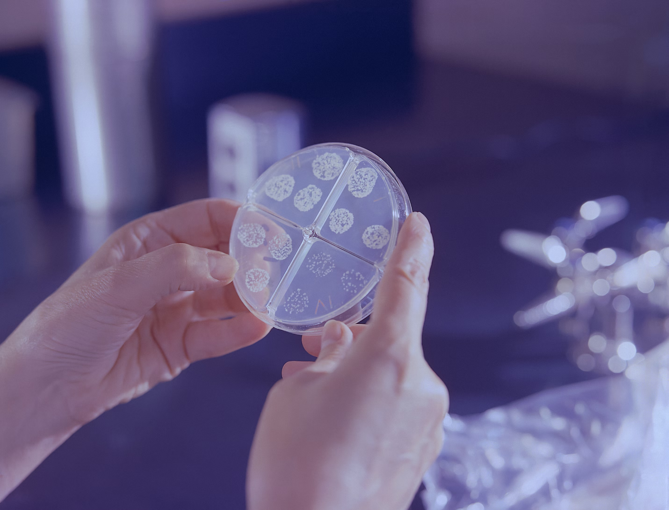
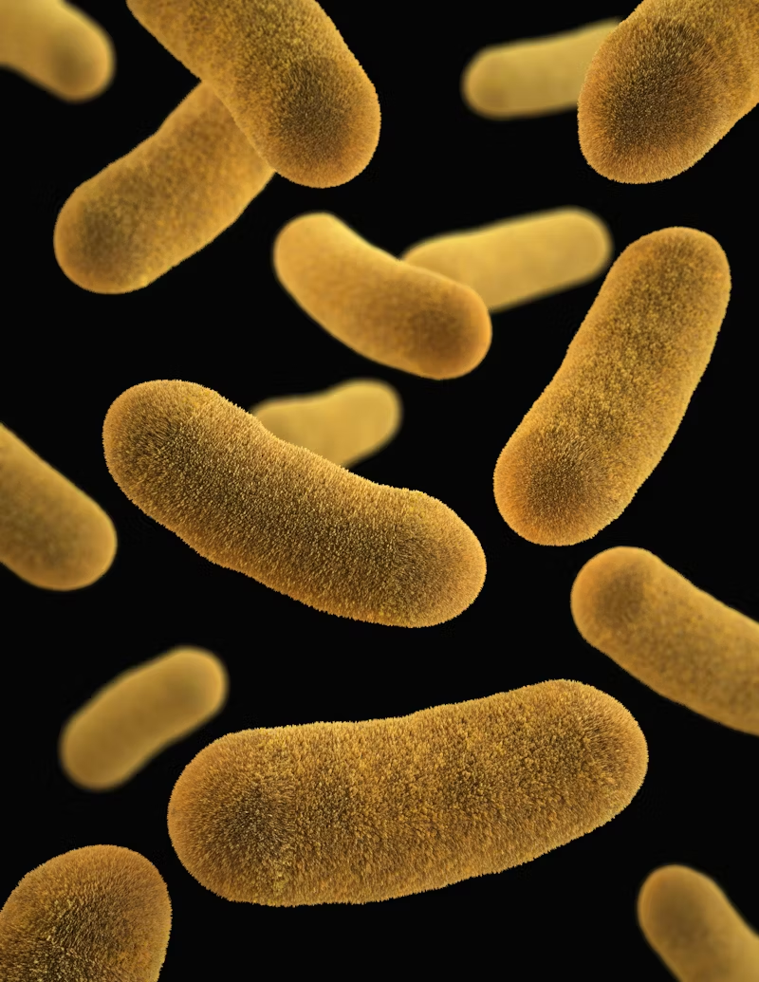
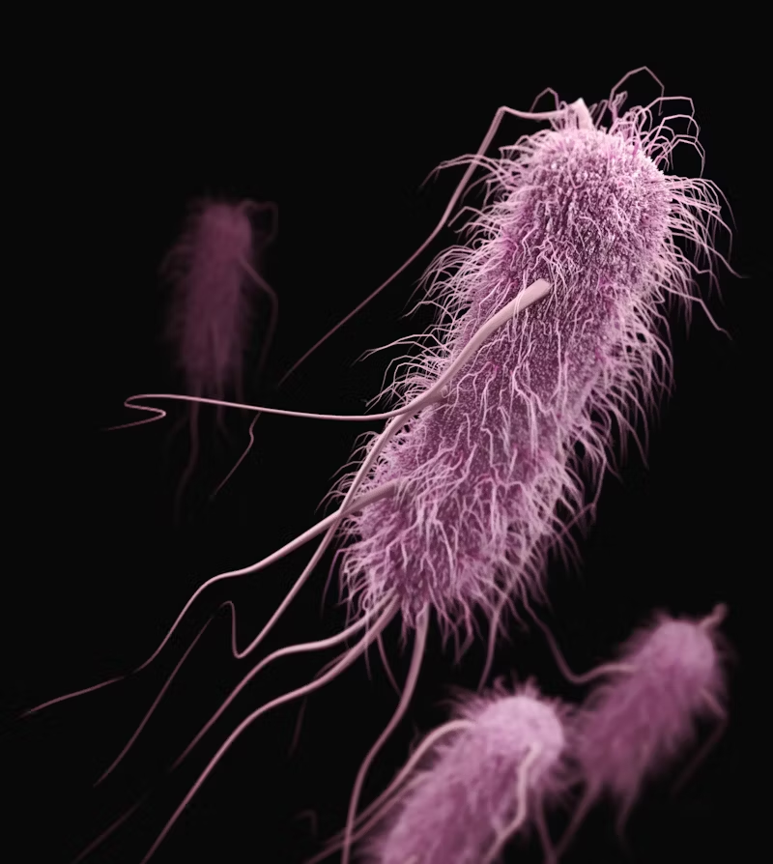
Antimicrobial Resistance
“Antimicrobial resistance (AMR) is one of the top global public health and development threats. It is estimated that bacterial AMR was directly responsible for 1.27 million global deaths in 2019 and contributed to 4.95 million deaths” [1]
Antibiotics are a key line of defense
Even simple cuts or wounds can lead to deadly outcomes
Use of antibiotics promotes further spread of resistance
Resistance = harder to treat infections and to predict which antibiotics will be effective

Slide 9
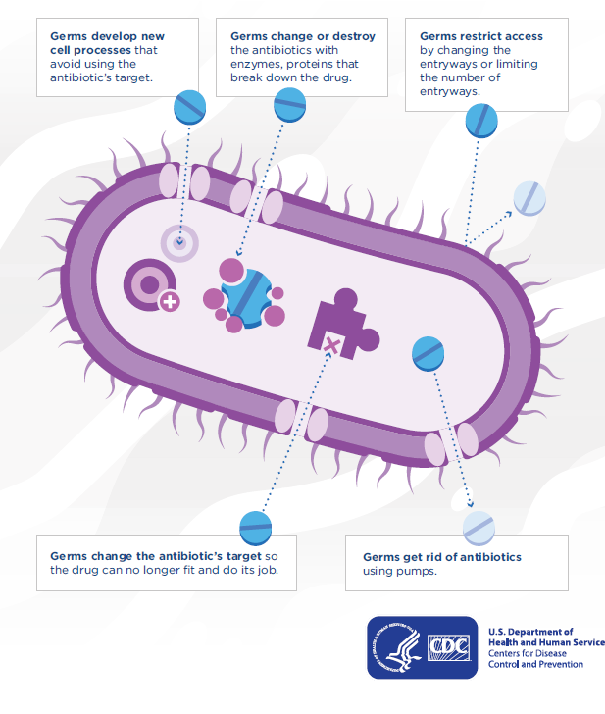
Resistance Overview
Antibiotics are varied in their mechanistic effect, only certain drugs will be effective against certain species
Binary Fission - bacteria divide to reproduce, these rapid division cycles can make bacteria susceptive to selective pressure
Mutations, gene transfer and bacteriophages all contribute to changes to the bacterial genome
A single base pair change in DNA could be completely inconsequential or result in a modified protein and phenotypic changes
[2]

Slide 10

Bacterial Genomes
Gene A
Bacterial Genome
Plasmids
Genome is Circular
AGCT nucleotides make up the fundamental building blocks of DNA
Strings of nucleotides encode for proteins - functional elements on the bacterial cell
Bacteria can also gain new pieces of DNA through conjugative transfer - these plasmids can carry resistance genes
AT and GC form pairs and DNA can be written in forward or reverse complements:
AACCCGA
TCGGGTT
Gene B
A : Adenine
C : Cytosyne
G : Guanine
T : Thymine

Slide 11
How does Data Science Help?
Data
Data Science is uniquely positioned to drive positive change when it comes to AMR and bacterial genomes
It is very difficult to experimentally determine and prove a causal relationship between a gene and a phenotype (see gene knockout studies [3])
Data science however is fantastic at picking out correlations amongst large, complex data sets
Data for supervised machine learning:
Bacterial antibiotic resistance can be measured
Bacterial genomes can be sequenced into nucleotide strings
Can we build models which leverage bacterial DNA data to predict AMR phenotype?
ML Model
Magic

Slide 12
Course Overview

Slide 13
Learning Objectives
This is fundamentally a Data Science project and the focus is on breaking down the Challenge into a reusable “data science process”
In data science, understanding the subject of application is always important, so learning about genomics and bacteria is crucial to being able to build a good solution
Objectives:
Tackle a data science (predictive modeling) problem from start to finish (e.g. a take home interview exercise)
Set up a reproducible Python environment and understand how to structure code for analysis
Process tabular data and sequencing data (bacterial genomes) into machine learning features
Train a well-fit machine learning model and comparison baseline model
Analyze machine learning models and understand how to use cross-validation and statistical tests to compare between models

Slide 14
Sessions Overview
Workshop 1 – Project Introduction & Setup
Workshop 2 – Genomic Data (A2 Assignment)
Workshop 3 – Data Analysis & Visualization (A3 Assignment)
Workshop 4 – Featurization & Baseline Modeling (A4 Assignment)
Workshop 5 – Model Training Approaches (Final Assignment Set)
Workshop 6 – Model Tuning
Workshop 7 – Performance Evaluation (Final Assignment Code/Testing Due)
Workshop 8 – Results Presentation & Wrap up (Final Presentation Due)

Slide 15
Accessing Files
One single place for accessing all course materials:
Through the main course folder (link to access here)
Notes:
Large Data files are only stored in the main course folder (under `data/`)
Final projects should be submitted in the `submissions/` folder - make a new folder with your name
Git and Github are not being taught as part of this course. Any existing familiarity?
Encourage you to use Git & Github for packaging and presenting your work (especially the final project)

Slide 16
Expectations

Slide 17
Office Hours and Getting Help
Three main methods for support during this course:
Office hours:
I’m available 3pm-4pm Fridays and 6pm-7pm Tuesdays
Reach out on slack (see below) or via email to book a slot in these times
Slack
There is a course slack channel, join using this link
Please join the “march-2025-workshop” channel
Use this channel for all questions, you are also encouraged and welcome to answer each others questions
Recordings of each workshop are available to rewatch in the course folder

Slide 18
Requirements for Course Completion
To formally complete the course you must:
Attend at least 5/8 workshops throughout the course (attending all 8 is highly encouraged!)
You must submit your final project assignment (this will be set on Workshop 5 and will be due for Workshop 8)
Each workshop is split into:
Career discussion & questions
Recap / Teaching Component (slides)
Interactive Tutorial (jupyter notebook)
Assignment (jupyter notebook)
Assignments are designed to be relatively short and example code is provided

Slide 19
Workshop 1 Setup

Slide 20
Set up File Structure
To make everything work smoothly, use the same directory structure as present in the course folder.
To get set up please:
Make a top level folder with the course name (all course files will live in here)
Make an empty ‘data’ folder within this top level folder (don’t download the data folder!)
Download Workshop 1 from the shared folder and place in the top level
Download the environment yaml file (first try the one called “etbg_env.yml” - if using windows you may need to use “etbg_env_nobio.yml”)
Resulting Structure:
ExploringTheBacterialGenome
data
Workshop 1 - Introduction & Setup
etbg_env.yml

Slide 21
Assignment - 0

Slide 22
What do you aim to achieve?
It’s important to put yourself in the right mindset and think about what you’re looking to learn!
I’m here to support you and help you get the most out of this project and reach your goals.
Prior to next week:
Write up a short paragraph on what you think you will learn from this course
Imagine you will be adding this to your resume/portfolio
You’ll come back to this paragraph at the end of the project as a reflection
Send this to me by next Friday (via email)

Slide 23
GitHub Usage
Quick Poll - What is everyone’s experience level with version control?
I won’t be formally teaching Git or using GitHub but it is a great habit to get into
Used extensively in industry
Option:
Push submissions and weekly progress to GitHub
Pair up to perform code reviews
Tag me in pull requests to get feedback
Will still need to upload submissions to the project folders

Slide 24
Final note on Workshops 3 & 5
Due to other commitments I’ll be unavailable on:
Friday 28th March (Workshop 3)
Friday 11th April (Workshop 5)
I plan to shift those workshops to another nearby day/time.
I appreciate everyone might not be able to make a new time but I will send out a poll via Slack shortly and try to optimize the adjust scheduling.
Records will, as usual, be available from the project folders.

Slide 25
References
[1] - https://www.thelancet.com/journals/lancet/article/PIIS0140-6736(21)02724-0/fulltext
[2] - https://www.cdc.gov/drugresistance/about/how-resistance-happens.html
[3] - https://www.ncbi.nlm.nih.gov/pmc/articles/PMC10440060/

